Slide 1
WELCOME TO ALL

Slide 2
SERMATHAI VASAN COLLEGE FOR WOMEM
TOPIC: RIVER EMBANKMENT
CODE: sk153
TEAM NAME: NET TACTERS
PARTICIPANTS NAME:
S. Kanniga deepa
S. Nagatharani
B. Sivasri
P. J. Indhumathy
G. Kiran kiruthiga
M. Sangareswari

Slide 3
Indrouction
An embankment is any long ridge made out of soil or rock. Embankments are used, for example, to carry railways over river floodplains. Most embankments, however, are placed alongside rivers to hold them in during times when otherwise the rivers might flood.
The project is a continuation of Flood Management Implementation Support Project Phase II initiated by the Bog to improve flood management within the State. Initiated as part of Flood Management Information System (FMIS).
The USP of EAMS is to provide FMISC a web based application tool that will provide user based access to relevant WRD officials so as to manage embankment assets and flood through the use of GIS.

Slide 4
Technology used
Android technology-SDK NDK development
Cloud support –user data store and other service
Open GLs, batch geo-aerial mapping (geo tagging),GIS
Open street view-geo location for the safety of the user
Microsoft azure signal service-(global GEO data tracking and storing)
Tensor flow-training the data models for ML

Slide 5
Dependencies
Aadhar details of every user –(crowd source login verification purpose
Training of data models to create alert notification of river embankment to officer-ML\AI of GEO spatial data
Minor river embankments details –(for aerial frame GEO data)

Slide 6
RIVER EMBANKMENT
As we all know the central water commission is a premier technical organization. In the field of water resource. The inspection and monitoring of health of embankment for preventive maintenance is a massive and intensive exercise which is huge financial ramification
ISSUE:
The manpower requirements for carrying out this task. Effectively is very high. This is because a wide network of embankment across river networks. At times some of the location are even not accessible .

Slide 7
Solution
To over come this issue we have came with technological solution towards the issue .
Our application is also has given two main modules that is
GSI SUPPORT
CROWD SOURCE DATA
In this participation of the local peoples to save guard public property and life.
The solution could be embankment mapping and crowd source health card.
In our solution embankment mapping involves the development of GIS application to analyze the existing river embankment network
Our GIS application is enhanced with DSVM. we use ESRI a land azure cloud technology in our GIS application that process the geo data

Slide 8
using ML trained models the GIS support we could analyze the new ,existing river embankment using the processed geo data
our application also has the crowd sourced data which will consist of image ,geo –location and time stamp can be used for the generation of the health card
the embankment and indemnifying the critical sections thereof for their preventive maintenance.
The capturing the images, geo –location and time stamp can be done through geo –tag with Azure cloud support.
In this GIS support play’s an important role
All the data models are trained using ML
So that end user can visualize and identify the critical and other river embankments.
The investigation officer will be notified if there is any high alert problem in river embankments the GIS supported crowd source data

Slide 9
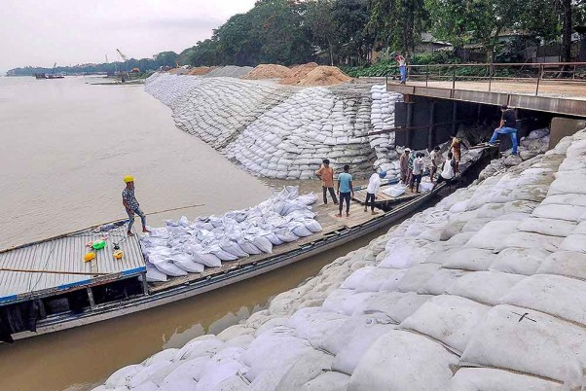
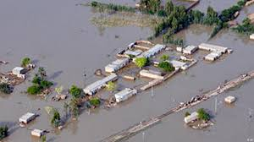
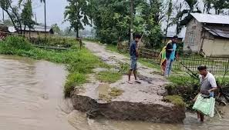
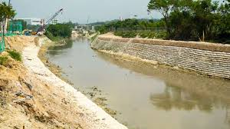
RIVER EMBANKMENT

Slide 10
REFERENCE
https://twitter.com/Indhu24799486/status/1286724462948147200?s=19

Slide 11
Thanking you

